Slide 1
Dot and Cross products

Slide 2
Dot product
The dot product of two vectors A and B is defined as:
B
A · B = |A| |B| cos θ
dot(A, B) = length(A) * length(B) * cos(θ)
θ
O
A
dot(A, B) = Ax * Bx + Ay * By + Az * Bz

Slide 3
Dot product
The result of the dot product is a scalar value.
It denotes the degree of projection of one vector onto the other.
If A is normalized (i.e. |A| == 1), dot(A, B) gives us the amount of B projected onto A.
B
θ
O
A
dot(A, B)
dot(A, B) = Ax * Bx + Ay * By + Az * Bz

Slide 4
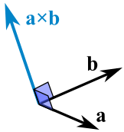
Cross product
The cross product of two vectors A and B is defined as:
A ⨉ B = |A| |B| sin θ N
cross(A, B) = length(A) * length(B) * cos(θ) * N

Slide 5
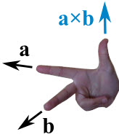
Cross product
It gives us a vector which is perpendicular to both A and B.
The Right Hand Rule tells us the direction of the resulting vector.

Slide 6
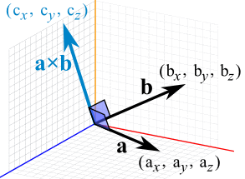
Cross product
The cross product of two vectors A and B can be computed as follows:
c_{x} = a_{y}b_{z} − a_{z}b_{y}
c_{y} = a_{z}b_{x} − a_{x}b_{z}
c_{z} = a_{x}b_{y} − a_{y}b_{x}

Slide 7
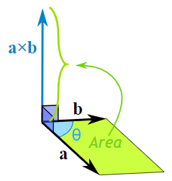
Cross product
The magnitude of the resulting vector is the area of the parallelogram defined by A and B.

Slide 8
Cross product
The magnitude of the resulting vector is the area of the parallelogram defined by A and B.
Most of the time we will be interested in the resulting vector direction, not magnitude, so remember to normalize the result before using it.

Slide 9
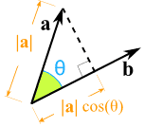
Dot product vs. Cross product
Dot product Result: A scalar value Projection of a onto b Normalize b to find the projection measure in the current base coordinates. | Cross product Result: A third vector Perpendicular to a and b Area of the parallelogram Right Hand Rule

